Slide 1
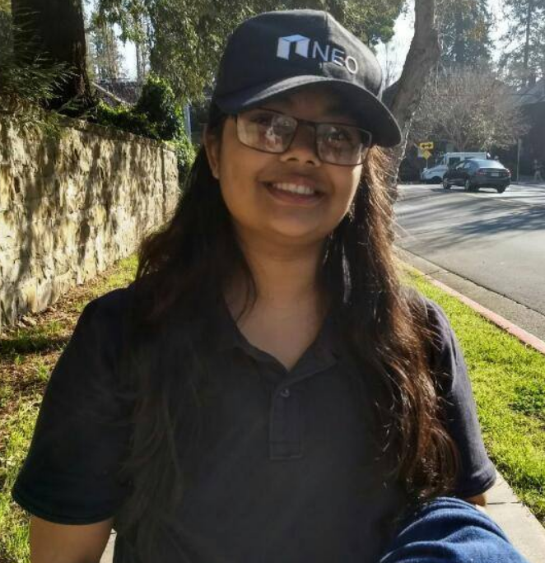
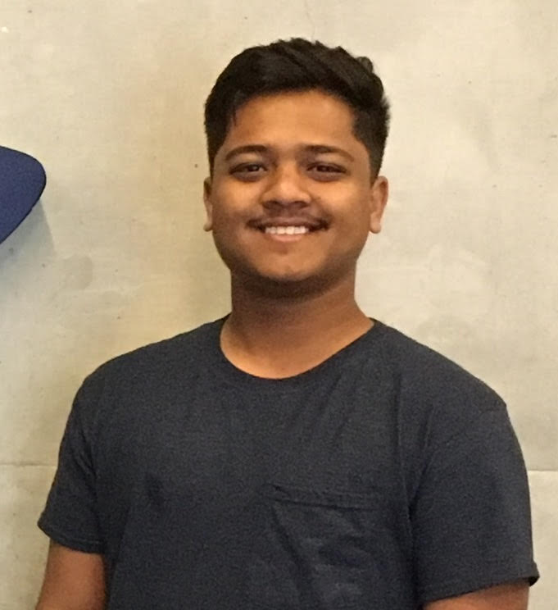


THE TEAM
Aayusi Biswas
Tuhin Sarkar
Vatsal Rathod
Abirami R.

Slide 2
The Problem
In the highly expensive and competitive education system in India, students require more personalized and cost effective academic support.
Getting Less Individual Attention
Expensive Tution Classes
Overcrowded Classrooms
Exam Tension

Slide 3
Presenting…
QUEST

Slide 4
Solution
An online (web/app) service that provides one to one interaction with skilled tutors for any kind of academic support.
On Demand
Personalized
Cost Effective
(As low as $4)
Easy UI

Slide 5
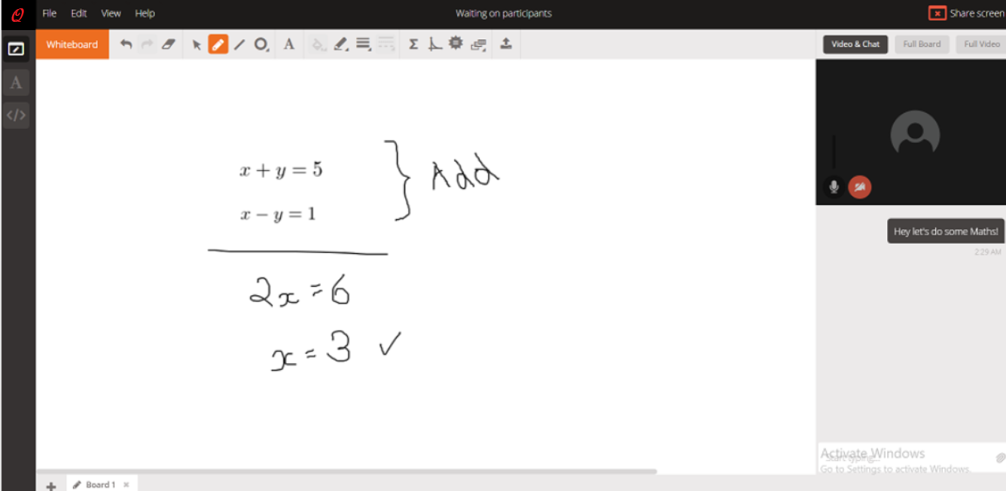
The interface.

Slide 6
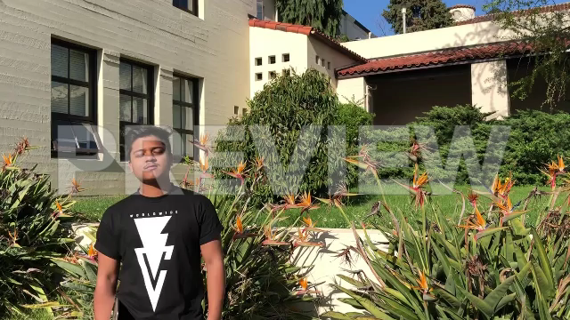
VIDEO LINK : https://youtu.be/GCkmZKseXa0

Slide 7
Try the Prototype.
Check it out!
Try the chatbot and see where it takes you ;-)
tinyurl.com/innovateatcal

